Slide 1
Introduction to Object-Oriented Development
Hiranya Prasad Bastakoti

Slide 2
Contents
Basic Characteristics of Object-Oriented Systems
Object-Oriented System Analysis and Design (OOSAD)
Introduction to Unified Modeling Language
Structural and Behavioral Diagrams

Slide 3
Introduction
Object-Oriented systems development life cycle
Process of progressively developing representation of a system component (or object) through the phases of analysis, design and implementation
The model is abstract in the early stages
As the model evolves, it becomes more and more detailed
20.3

Slide 4
The Object-Oriented Systems Development Life Cycle
Analysis Phase
Model of the real-world application is developed showing its important properties
Model specifies the functional behavior of the system independent of implementation details
Design Phase
Analysis model is refined and adapted to the environment
Can be separated into two stages
System design
Concerned with overall system architecture
Object design
Implementation details are added to system design
20.4

Slide 5
The Object-Oriented Systems Development Life Cycle
Implementation Phase
Design is implemented using a programming language or database management system
20.5

Slide 6
The Object-Oriented Systems Development Life Cycle
Deliverables and Outcomes
The ability to tackle more challenging problem domains
Improved communication among users, analysts, designers and programmers
Increased consistency among analysis, design and programming activities
Explicit representation of commonality among system components
Reusability of analysis, design and programming results
Increased consistency among the models developed during object-oriented analysis, design, and programming
20.6

Slide 7
The Unified Modeling Language (UML)
A notation that allows the modeler to specify, visualize and construct the artifacts of software systems, as well as business models
Techniques and notations
Use cases
Class diagrams
State diagrams
Sequence diagrams
Activity diagrams
20.7

Slide 8
Structural Diagram
The structural diagrams represent the static aspect of the system.
These static aspects represent those parts of a diagram, which forms the main structure and are therefore stable.
Class diagram
Object diagram
Component diagram
Deployment diagram

Slide 9
Behavioral Diagrams
Behavioral diagrams basically capture the dynamic aspect of a system.
Dynamic aspect can be further described as the changing/moving parts of a system.
Use case diagram
Sequence diagram
Collaboration diagram
Statechart diagram
Activity diagram

Slide 10
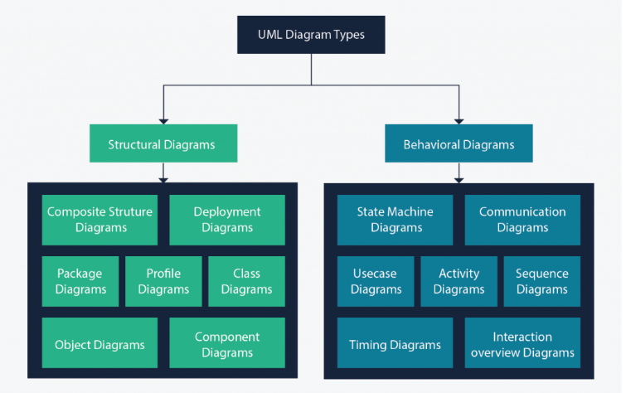
Structural and Behavioral Diagrams

Slide 11
Use-Case Modeling
Applied to analyze functional requirements of the system
Performed during the analysis phase to help developers understand functional requirements of the system without regard for implementation details
Use Case
A complete sequence of related actions initiated by an actor
Actor
An external entity that interacts with the system
20.11

Slide 12
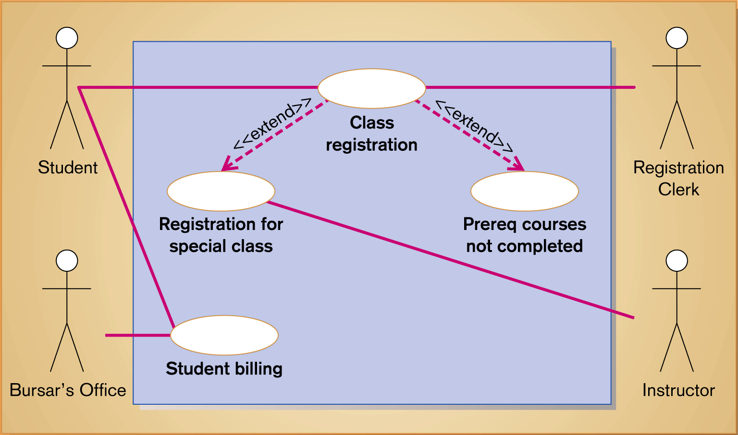
Figure 20-2 Use-case diagram for a university registration system
20.12

Slide 13
Use-Case Modeling
Developing Use-Case Diagrams
Use cases are always initiated by an actor
Use cases represent complete functionality of the system
Relationships Between Use Cases
Use cases may participate in relationships with other use-cases
Two types
Extends
Adds new behaviors or actions to a use case
Include
One use case references another use case
20.13

Slide 14
Object Modeling Class Diagrams
Object
An entity that has a well-defined role in the application domain, and has state, behavior, and identity
State
A condition that encompasses an object’s properties and the values those properties have
Behavior
A manner that represents how an object acts and reacts
Object Class
A set of objects that share a common structure and a common behavior
20.14

Slide 15
Object Modeling Class Diagrams
Class Diagram
Class is represented as a rectangle with three compartments
Objects can participate in relationships with objects of the same class
20.15

Slide 16
Object Modeling Object Diagrams
Object Diagram
A graph of instances that are compatible with a given class diagram; also called an instance diagram
Object is represented as a rectangle with two compartments
Operation
A function or service that is provided by all the instances of a class
Encapsulation
The technique of hiding the internal implementation details of an object from its external view
20.16

Slide 17
Object Modeling Object Diagrams
Types of Operations
Query
An operation that accesses the state of an object but does not alter the state
Update
An operation that alters the state of an object
Scope
An operation that applies to a class rather than an object instance
Constructor
An operation that creates a new instance of a class
20.17

Slide 18
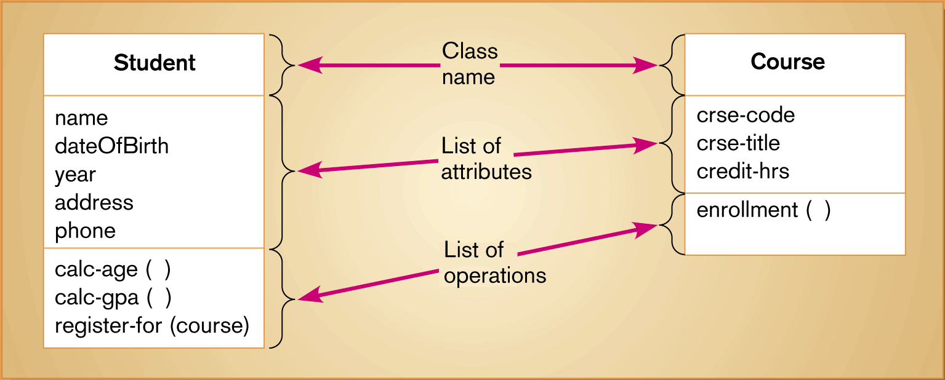
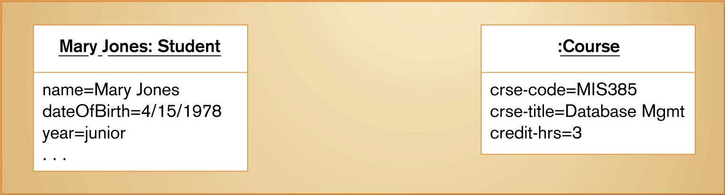
Figure 20-5 UML class and object diagrams (a) Class diagram showing two classes (b) Object diagram with two instances
20.18

Slide 19
Representing Associations
Association
A relationship between object classes
Degree may be unary, binary, ternary or higher
Depicted as a solid line between participating classes
Association Role
The end of an association where it connects to a class
Each role has multiplicity, which indicates how many objects participate in a given association relationship
20.19

Slide 20
Representing Association Classes
Association Class
An association that has attributes or operations of its own, or that participates in relationships with other classes
Similar to an associative entity in ER modeling
Figure 20-9 shows one example
20.20

Slide 21
Representing Derived Attributes, Derived Associations and Derived Roles
Derived attributes, associations and roles can be computed from other attributes, associations or roles
Shown by placing a slash (/) before the name of the element
20.21

Slide 22
Representing Generalization
Generalization
Abstraction of common features among multiple classes, as well as their relationships, into a more general class
Subclass
A class that has been generalized
Superclass
A class that is composed of several generalized subclasses
20.22

Slide 23
Representing Generalization
Discriminator
Shows which property of an object class is being abstracted by a generalization relationship
Inheritance
A property that a subclass inherits the features from its superclass
Abstract Class
A class that has no direct instances, but whose descendents may have direct instances
Concrete Class
A class that can have direct instances
20.23

Slide 24
Representing Generalization
Semantic Constraints among Subclasses
Overlapping
A descendant may be descended from more than one of the subclasses
Disjoint
A descendant may not be descended from more than one of the subclasses
Complete
All subclasses have been specified. No additional subclasses are expected
Incomplete
Some subclasses have been specified, but the list is known to be incomplete
20.24

Slide 25
Representing Generalization
Class-scope Attribute
An attribute of a class which specifies a value common to an entire class, rather than a specific value for an instance.
Abstract Operation
Defines the form or protocol of an operation but not its implementation
Method
The implementation of an operation
Polymorphism
The same operation may apply to two or more classes in different ways
20.25

Slide 26
Interpreting Inheritance and Overriding
Overriding
Process of replacing a method inherited from a superclass by a more specific implementation of that method in a subclass
Three Types
Overriding for Extension
Operation inherited by a subclass from its superclass is extended by adding some behavior
Overriding for restriction
The protocol of the new operation in the subclass is restricted
Overriding for optimization
The new operation is implemented with improved code by exploiting the restrictions imposed by a subclass
20.26

Slide 27
Representing Multiple Inheritance
Multiple Classification
An object is an instance of more than one class
Use is discouraged and not supported by UML semantics
Multiple Inheritance
Allows a class to inherit features from more than one superclass
20.27

Slide 28
Representing Aggregation
Aggregation
A part-of relationship between a component object and an aggregate object
Example: Personal computer
Composed of CPU, Monitor, Keyboard, etc
20.28

Slide 29
Dynamic Modeling: State Diagrams
State
A condition during the life of an object during which it satisfies some conditions, performs some actions or waits for some events
Shown as a rectangle with rounded corners
State Transition
The changes in the attribute of an object or in the links an object has with other objects
Shown as a solid arrow
Diagrammed with a guard condition and action
Event
Something that takes place at a certain point in time
20.29

Slide 30
Dynamic Modeling: Sequence Diagrams
Sequence Diagram
A depiction of the interaction among objects during certain periods of time
Activation
The time period during which an object performs an operation
Messages
Means by which objects communicate with each other
20.30

Slide 31
Dynamic Modeling Sequence Diagrams
Synchronous Message
A type of message in which the caller has to wait for the receiving object to finish executing the called operation before it can resume execution itself
Simple Message
A message that transfers control from the sender to the recipient without describing the details of the communication
20.31

Slide 32
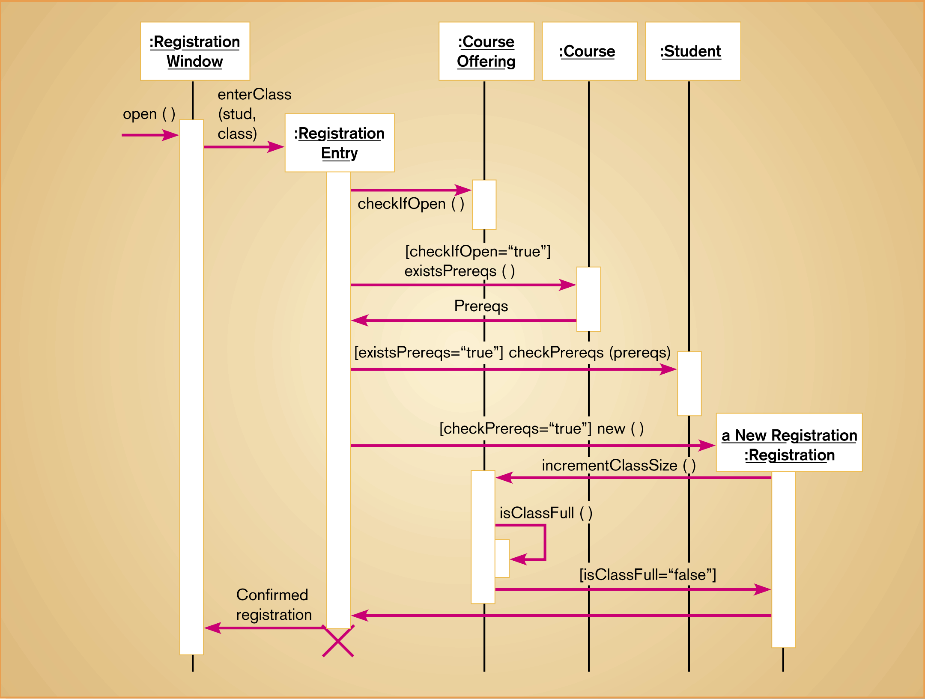
Figure 20-24 Sequence diagram for a class registration scenario with prerequisites
20.32

Slide 33
Process Modeling: Activity Diagrams
Shows the conditional logic for the sequence of system activities needed to accomplish a business process
Clearly shows parallel and alternative behaviors
Can be used to show the logic of a use case
20.33

Slide 34
Analysis Versus Design
Start with existing set of analysis model
Progressively add technical details
Design model must be more detailed than analysis model
Component Diagram
A diagram that shows the software components or modules and their dependencies
Deployment Diagram
A diagram that shows how the software components, process and objects are deployed into the physical architecture of the system
20.34

